Slide 1

Balancing rigor, inclusiveness and feasibility
Learnings from the design of a participatory impact evaluation of the IFAD-funded RTIMP in Ghana.
UKES May 2015 London
Glowen Kyei-Mensah (PDA)
Adinda Van Hemelrijck & Irene Guijt (IFAD & BMGF)

Slide 2
Impact Evaluation under IFAD9
80m people out of poverty?
Participation of people?
Attribution of complex government programs?
Learning with partners?
Notes:
IMI -> learning initiative
International development desperate to ‘prove impact’
In context where IFAD had committed to 30 impact evaluations under the 9th replenishment
“number of people lifted out of poverty” Extractive, for funders, statistical rigour
Ignores participation
Limited feasibility: how to evaluate complex multi-level and multi-actor systemic change programs with things like self-targeting mechanisms and interferance of many other players and fuders?
both the IOE and SSD are struggling with finding appropriate approaches serving both learning and accountability purposes and capturing the complexity of the IFAD-funded projects
Part of IFAD’s ‘Improved Learning Initiative’
generates rigorous, contested & debated evidence of project contributions to and explanations of rural poverty impact
facilitates meaningful and equal participation of project stakeholders in collecting and analysing the evidence;
presents a potentially scalable model for strengthening IFAD’s self-evaluation system
Facilitate reflections with stakeholders at field, country and global levels on the quality of the PIALA in terms of:
Rigour: consistency and reliability of methods, processes & evidence
Utility: accessibility, credibility and value of methods to generate useful insights to influence decisions, processes and relations
Feasibility: replicability, manageability and cost-effectiveness of methods and processes

Slide 3
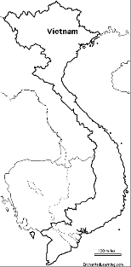
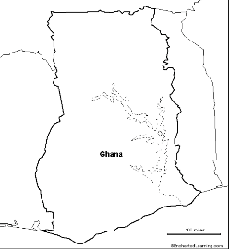
Improved learning initiative for the piloting of a Participatory Impact Assessment & Learning Approach (PIALA)
DBRP
RTIMP
$ 90 K
$ 260 K
✔
✔
Almost
Notes:
IMI -> learning initiative
International development desperate to ‘prove impact’
In context where IFAD had committed to 30 impact evaluations under the 9th replenishment
“number of people lifted out of poverty” Extractive, for funders, statistical rigour
Ignores participation
Limited feasibility: how to evaluate complex multi-level and multi-actor systemic change programs with things like self-targeting mechanisms and interferance of many other players and fuders?
both the IOE and SSD are struggling with finding appropriate approaches serving both learning and accountability purposes and capturing the complexity of the IFAD-funded projects
Part of IFAD’s ‘Improved Learning Initiative’
generates rigorous, contested & debated evidence of project contributions to and explanations of rural poverty impact
facilitates meaningful and equal participation of project stakeholders in collecting and analysing the evidence;
presents a potentially scalable model for strengthening IFAD’s self-evaluation system
Facilitate reflections with stakeholders at field, country and global levels on the quality of the PIALA in terms of:
Rigour: consistency and reliability of methods, processes & evidence
Utility: accessibility, credibility and value of methods to generate useful insights to influence decisions, processes and relations
Feasibility: replicability, manageability and cost-effectiveness of methods and processes

Slide 4
Objectives
& Purposes
1. Produce rigorous qualitative and quantitative evidence for global reporting and advocacy
Assessing to what extent impacts occurred (or not)
Debating how impacts can be enhanced
Explaining why impacts occurred (or not)
REPORRTING
ADVOCACY
3. Generate a scalable model for strengthening IFAD’s self-evaluation system
2. Facilitate inclusive analysis and reflection for collaborative learning
LEARNING

Slide 5
Design challenges
Serving the different purposes with limited budgets
Understanding the typical attributes of IFAD-funded government programs
Generating solid conversation about “what has worked for whom, under which conditions and why?”
Notes:
(not performance): to generate solid conversation about critical issues related to “What works how, for whom, under which conditions and why?”
indicators of rural poverty (nutrition, food & income, assets) and enablers (capitals, institutions, relations/processes) incl. WEIA & SLA
contribution analysis of complex multi-causal interactions, using mixed-methods, recall, cross-validation & triangulation
facilitation of group-based causal change mapping and analysis and cross-validation debates

Slide 6
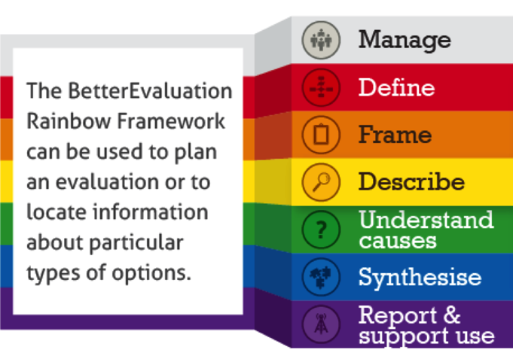
PIALA Quality Assurance Framework
Evaluation Design
Rigour
Inclusiveness
Feasibility
Focus & frame the evaluation
Describe & link changes
Identify causes
Manage quality
Synthesise findings
Analyse & debate contributions
Report & share
http://www.participatorymethods.org/authors/adinda-van-hemelrijck-and-glowen-kyei-mensah
Notes:
Add Rainbow Framework visual

Slide 7
Focusing & framing the evaluation
Upfront discussion with sponsors about design options (scope & scale) and budgets
Reconstruction of Theory of Change based on desk review and consultations
Design workshop with national stakeholders for identifying
Impact & contribution claims
Core assumptions
Evaluation & learning questions

Slide 8
Roots & Tubers Improved Marketing Program (30m)
FFF
MEF
GPC
DSF

Slide 9
Impact claim – Poverty reduction

Slide 10
Contribution Claim 3 – Enhanced R&T processing

Slide 11
Describing & linking changes
Selection of appropriate methods specific to the links and questions:
HH survey – correlation between changes in “access to food & income” and R&T livelihood changes and investments
PRA-based methods – causes of R&T livelihood changes and investments
SenseMaker lithe – patterns in experiences of “R&T livelihood changes” (400)
Constituent feedback – effects and reach of selected program mechanisms (DSF, FFF, MEF & GPC)

Slide 12
3 zones
8 regions
4 commodity chains
25 random districts
30 community clusters
150 Parti FGDs (with 1200 ppts, 45% women)
Parti Sensemaking (in 23 districts with 640 ppts; national with 100 ppts)
100 KIIs with officials, bankers, researchers, enterprises…
860 HH Surveys
Notes:
HH survey on food & income, community orgs membership, credit sources/use and training (gender-disaggregated)
in 720 HHs (540+180) in 24 villages (18+6) sufficient for comparison with RIMS baseline (900 HHs)
Participatory causal change mapping of livelihoods and institutional relationships (gender-specific), and wealth & wellbeing (gender-mixed)
with ± 550 participants (390+130) in 8 villages (6+2) sufficient for causal explanation
KIIs and FGDs on institutional capacity at communes, districts & province
with ± 80 leaders & officials in 8 villages/communes (6+2), ± 15-20 officials in 3 districts, and ± 20 provincial and national officials
Multi-stage cluster sampling
From 2008 project population (26 communes/villages)
From salt, brackish and fresh water agro-ecological zones (3 districts)
Stratification according to distance (2km) to inter-communal road
Random selection of 18 ‘focus’ and 6 ‘non-focus’ villages, and 30 HHs per village

Slide 13
Analysing & debating contributions
Configurational analysis and integrated QUAL-QUANT synthesis
Systematic collation of data from the different methods at district and aggregated levels (with 0-6 rating of strength of links and evidence for each cluster)
Analysis of patterns in the evidence resulting from different with/without configurations across districts for each cluster
Sensemaking involving stakeholders in a collective analysis and debate of evidence of impact and contributions

Slide 14
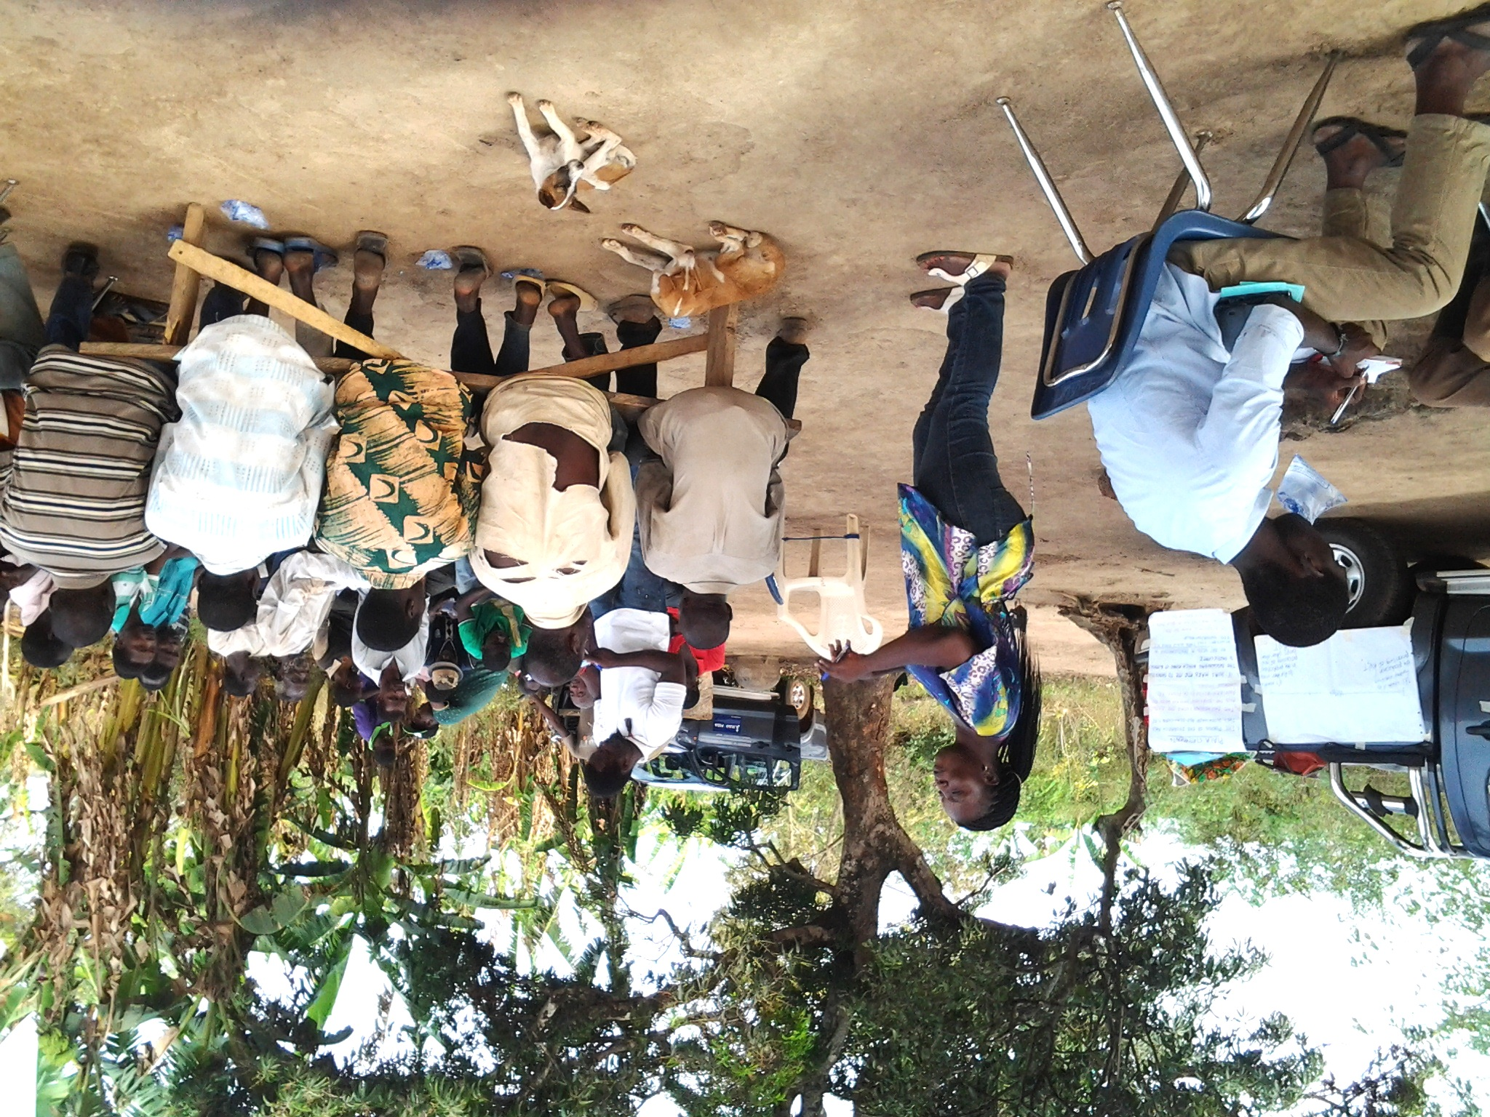
PIALA QAF:
Trade-offs under budget constraints?
Rigour
Inclusiveness
Feasibility
Describe & link changes
Identify the causes
Manage quality
Multi-stage sampling enabling comparative analysis of with/without configurations of program treatment
Nested mixed-methods
consistent and equal QUANT & QUAL data collection relevant to the links & questions
complementarity of types of information
Triangulation of different sources & types of data
Instant data entry and linking enabling on-site integrated analysis and sensemaking
Data quality monitoring and process reflection every evening while doing data collation
8 regions, 3 zones
30 clusters in 25 districts (propotional to CC size)
30 HHs/ cluster (tot 900)
40 participants/cluster (tot 1200, 45% women)
Field research capacity (nr of teams, time in the field, logistics & mobilization, supervision & quality assurance, time for instant data processing)
Classic HH survey
PRA-based methods
Testing of new tools (SenseMaker & CF) to overcome respondent & researcher bias
District sensemaking workshops
Process vs data (R + I)
Participation vs independence (R + I)
Scope vs depth (F + I)
Scale vs voice (R + I)
Notes:
Add Rainbow Framework visual

Slide 15
Final notes
Capturing variability in program treatment
Involving policy-makers, donors & constituents
Harvesting the best of all
Capacity trumps all
Value for money?
Answering the questions
@ baseline mid & end?
Replicability?
Notes:
IMI -> learning initiative
International development desperate to ‘prove impact’
In context where IFAD had committed to 30 impact evaluations under the 9th replenishment
“number of people lifted out of poverty” Extractive, for funders, statistical rigour
Ignores participation
Limited feasibility: how to evaluate complex multi-level and multi-actor systemic change programs with things like self-targeting mechanisms and interferance of many other players and fuders?
both the IOE and SSD are struggling with finding appropriate approaches serving both learning and accountability purposes and capturing the complexity of the IFAD-funded projects
Part of IFAD’s ‘Improved Learning Initiative’
generates rigorous, contested & debated evidence of project contributions to and explanations of rural poverty impact
facilitates meaningful and equal participation of project stakeholders in collecting and analysing the evidence;
presents a potentially scalable model for strengthening IFAD’s self-evaluation system
Facilitate reflections with stakeholders at field, country and global levels on the quality of the PIALA in terms of:
Rigour: consistency and reliability of methods, processes & evidence
Utility: accessibility, credibility and value of methods to generate useful insights to influence decisions, processes and relations
Feasibility: replicability, manageability and cost-effectiveness of methods and processes

Slide 16
